Slide 1
Extra CarePass Initiative
Zach Karr, store 2936

Slide 2
Through the Values in Action point system
Additional incentive on top of the $3.00 sale incentive
3 sales a week = 25 value in Action Points
5 sales a week = 50 Value in Action Points

Slide 3
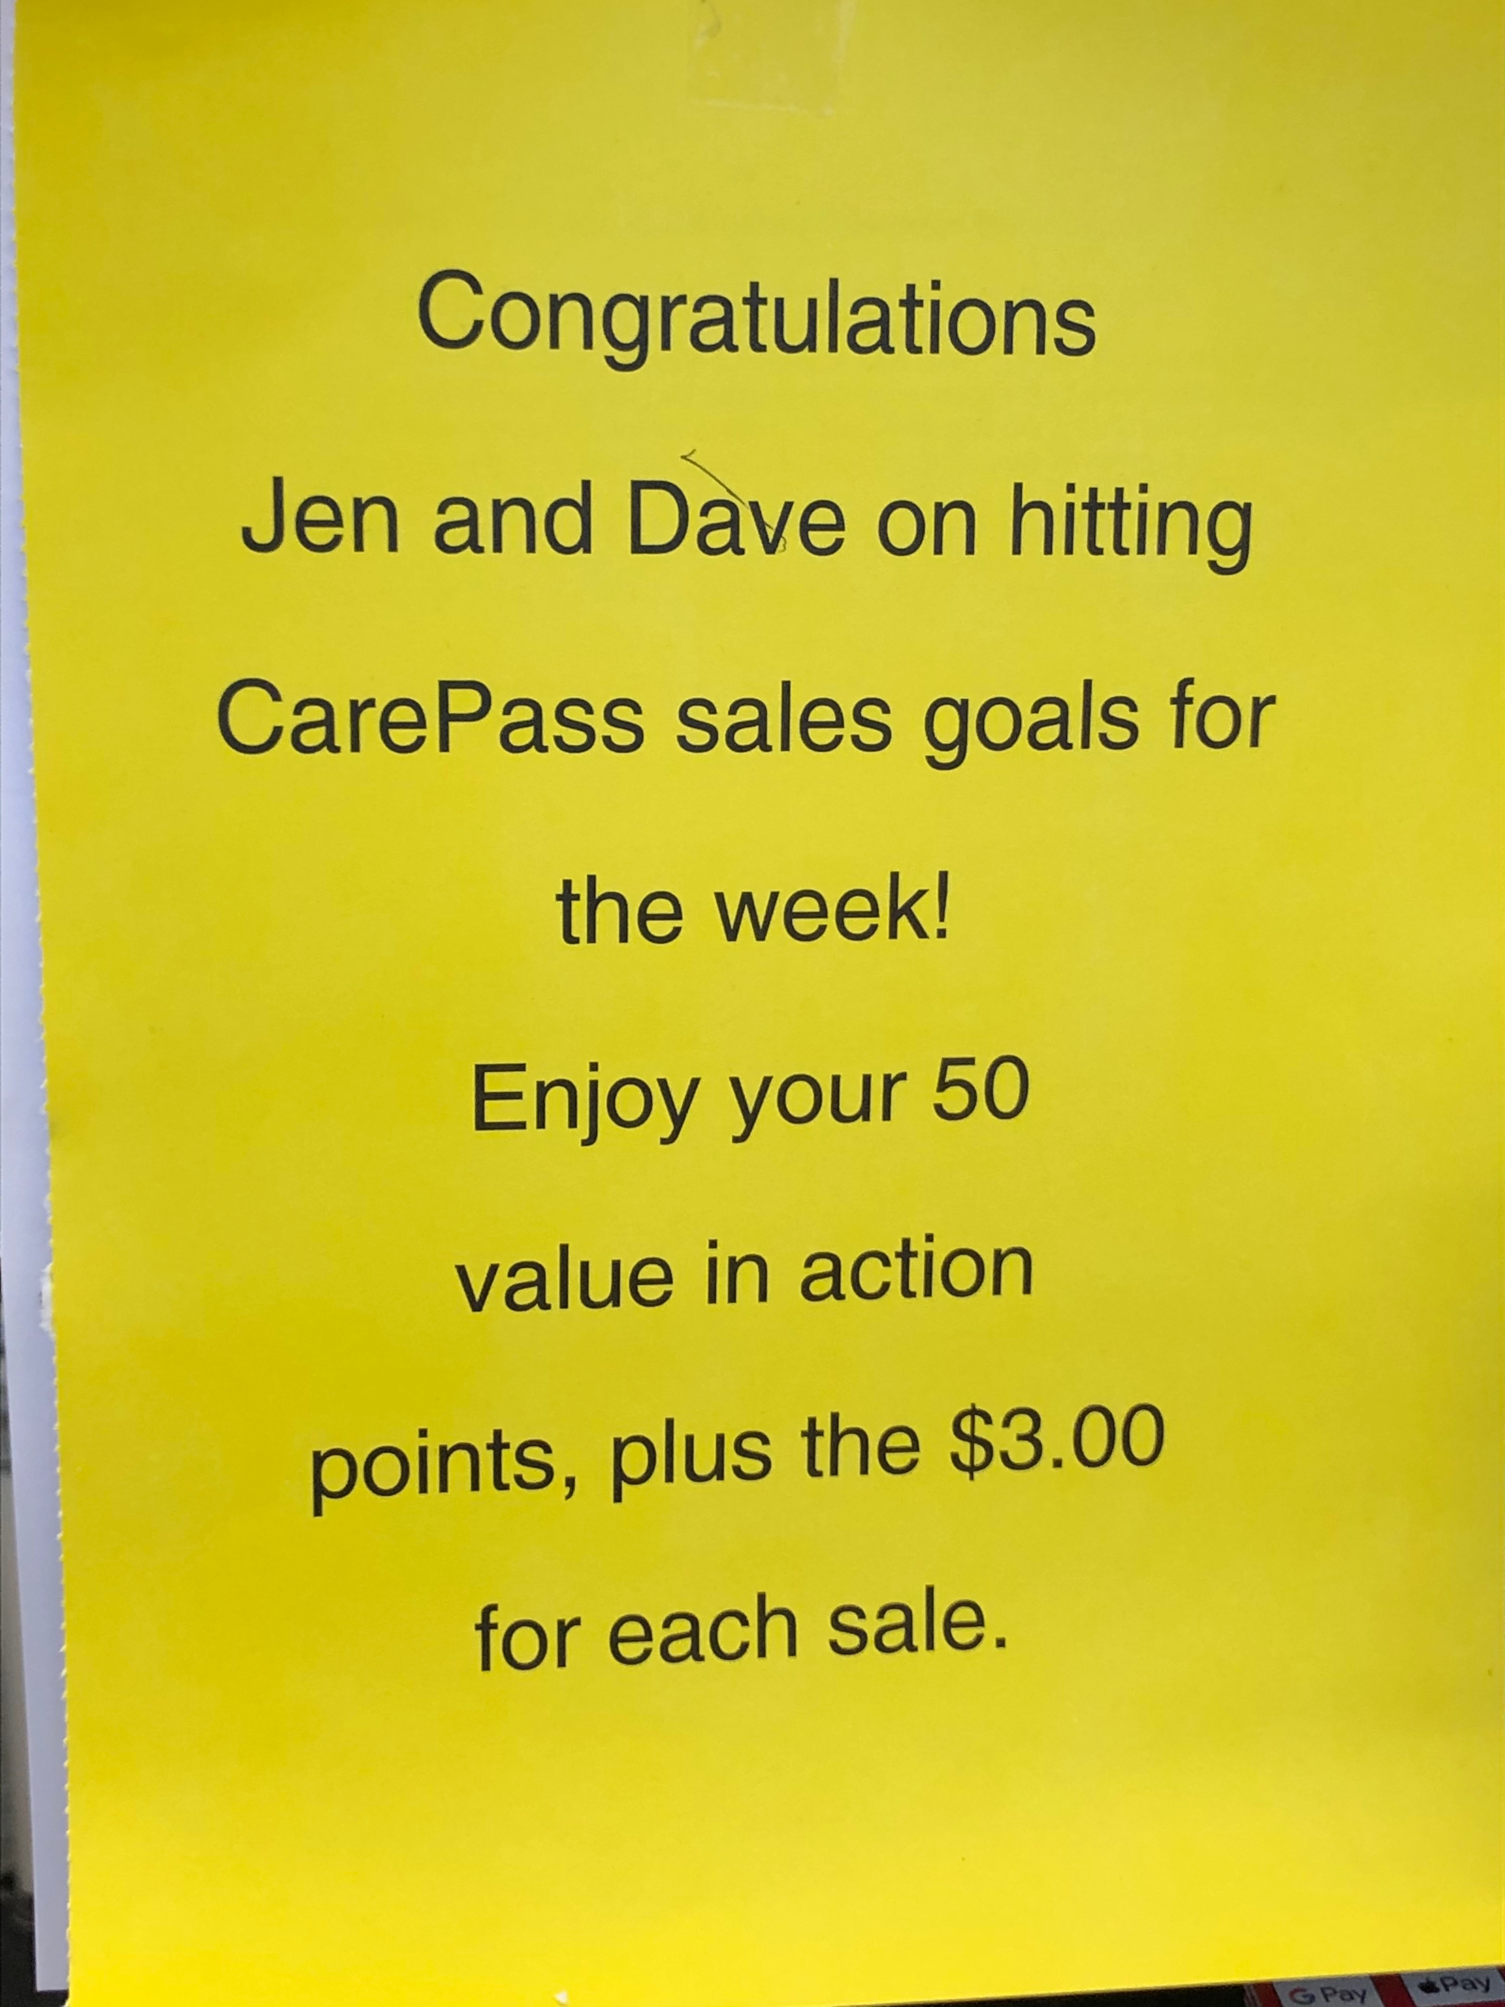
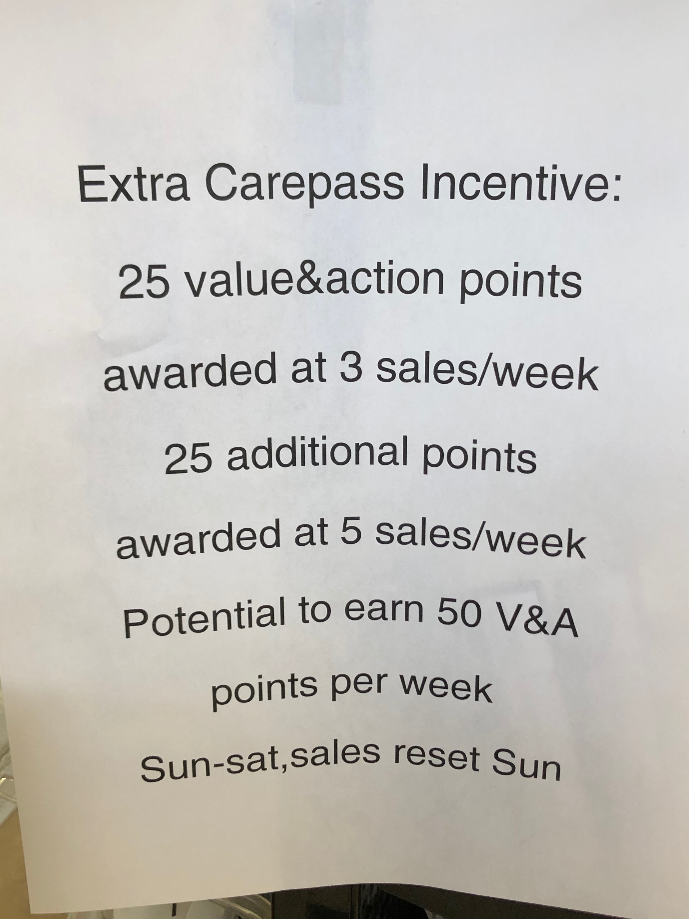
Recognition and Acknowledgements

Slide 4
Goals
To increase CarePass weekly sales numbers
21 a week (116% VS established goal)
To increase employee participation
6 a week
To further acknowledge successful salespeople
VinA Points + store recognition

Slide 5
Initiative put into place at week 27

Slide 6
More Consistency Hit already established CarePass goal every week, (week 28) Hit project goal weeks 27 and 30

Slide 7
Comparisons
AVG SALES PER WEEK BEFORE INITIATIVE: | 18.7142857 | AVG SALES AFTER INITIATIVE: | 20.25
AVG % VS GOAL WEEKLY BEFORE INITIATIVE: | 104% | AVG % GOAL VS WEEKLY AFTER INITIATIVE: | 112%
AVG # of EMPLOYEES BEFORE INITIATIVE: | 3.85714286 | AVG # OF EMPLOYEES AFTER INITIATIVE: | 4.25

Slide 8
Regression Statistics
Multiple R | 0.38745981
R Square | 0.1501251
Adjusted R Square | -1.25
Standard Error | 6.11510388
Observations | 1
Regression Analysis between CarePass Sales VS #Number of Employees Participating
Low R Sqaure
Standout salespeople
Consistent participation
High Standard of Error
Small Sample Size*

Slide 9
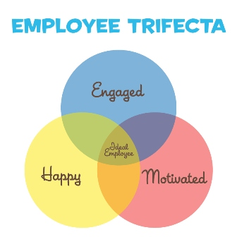
Reflection
Increase in sales fell just short of project goal
Strong trends in the right direction
Week 28
Increase in employee participation not what I had hoped
Increased Acknowledgement/Employee Feedback successful

Slide 10

Conclusion
The Initiative resulted in more consistent sales, positive trends
Initiative was not enough to increase employee participation
Problems: uncomfortable, no training, unsure what to say
Solutions: training classes or modules, written scripts
Found personal relationships to be far more impactful

Slide 11

THANKS !

